Slide 1
MALIGNANT EPITHELIAL OVARIAN TUMOURS
Dr NIMMY .P

Slide 2
Malignant Ovarian tumours
Types
Risk factors
Screening
Pathology
Staging
Clinical features
Diagnosis and management

Slide 3
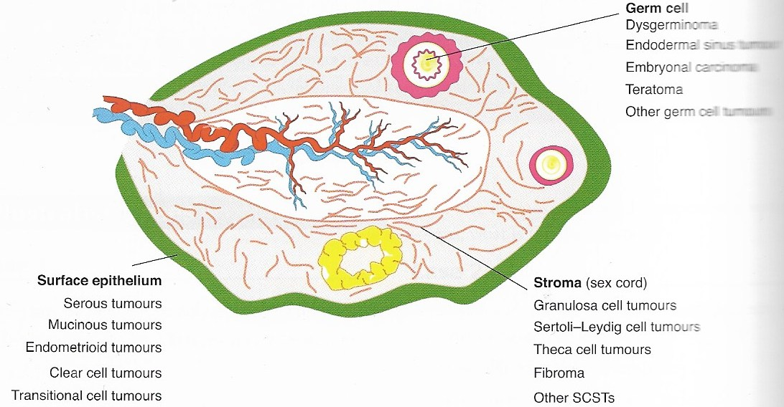
Malignant Ovarian tumours

Slide 4
Malignant Ovarian tumours
Risk factors
Older age group
Infertility and nulliparity
Early menarche and late menopause
Endometriosis, PID
FH of Ca- Ovary, breast, endometrium, colon
Perineal exposure to talc
White race
Diet rich in animal fat

Slide 5
Epithelial ovarian tumours
90% of ov trs are of epithelial origin
D/s of the elderly, between 60-70 yrs
Usually diagnosed in advanced stage –III or IV
Overall 5 yr survival rate is 20%

Slide 6
Incessant ovulation- aetiology
Hereditary- HNPCC(Lynch II) syndrome
Breast –ovarian Ca syndrome- mutation of BRCA 1,2 genes
Site specific Ov Ca- occur at an younger age than sporadic Ca

Slide 7
Screening for epithelial ov Ca
Yearly pelvic examination
TVS-
Ov volume >10ml, Solid/complex mass
Multiloculated with thick septa>2mm
Cyst wall>3mm
B/L, Papillary excrescences
Increased vascularity, RI<0.4
Tumour markers- CA125, CA19-9, CEA, CA15-3, lipid associated sialic acid, osteopontin

Slide 8
Proteomic patterns- proteins and their fragments in blood due to genetic mutation
Genetic testing when indicated- by FH- BRCA 1,2
Multimodal screening
Risk of malignancy index- RMI

Slide 9
Prevention
Oral contraceptives
Prophylactic BSO
Prophylactic salpingiectomy
Tubal sterilisation
Hysterectomy

Slide 10
Classification of epi ov Ca
Serous adenocarcinoma
Mucinous trs-
adeno Ca
pseudomyxoma peritonei
Endometrioid trs-
adeno Ca
Malignant mixed Mullerian tr
Clear cell adeno Ca
Transitional cell tumours-
malignant Brenner
Transitional cellCa
Rare trs-
mixed Ca,
sq cell ca, small cell ca, undiff ca

Slide 11
Pathology
Vary in size
Solid or varying consistency
Papillary excrescences inside and on the capsule
Highly vascular
Haemorrhage and necrosis common

Slide 12
 | CELLULAR TYPE | OTHER FEATURES | FREQUENCY
SEROUS | FALLOPIAN TUBE | PSAMMOMA BODIES | 80%
MUCINOUS | ENDOCERVICAL | MUCIN SECRETING CELLS | 10%
ENDOMETRIOID | ENDOMETRIAL | WELL DIFFERENTIATED | 10%
CLEAR CELL | MULLERIAN | CLEAR AND HOB NAIL CELLS | <1%
TRANSITIONAL CELL | TRANSITIONAL CELL | DENSE, ABUNDANT STROMA | <1%

Slide 13
Borderline epithelial trs
Trs of Low Malignant Potential (LMP)
10- 15%of epithelial trs
Cellular features of malignancy+
No stromal invasion
Most often serous or mucinous
Pseudomyxoma peritonei in mucinous trs
Mets can be borderline or invasive
Well differentiated, moderately diff, poorly diff

Slide 14
Secondary trs of ovary- Krukenberg’s tr
Primary maybe breast or GI Ca
Spread by transcoelomic or hematogenous route
B/L solid trs, mobile, maintain shape of ovary, bosselated surface
Signet ring cells seen
Non Krukenberg secondaries also occur

Slide 15
Primary peritoneal Ca
Resemble serous Ca Ovary
Clinical features , course and management similar to epithelial ov trs

Slide 16
Patterns of spread
Trans coelomic
Omentum,
surfaces of abd organs,
diaphragm under surface,
peritoneal surfaces
Lymphatic-
para aortic and pelvic nodes
Direct spread-
uterus, tubes, rectosigmoid, pelvis
Haematogenous–
liver, lung, brain

Slide 17
STAGING
Stage I - Growth limited to ovaries
Stage II - Growth involving one or both ovaries with pelvic extension

Slide 18
Stage III - Tr involving one or both ov with peritoneal implants outside the pelvis+/_ RP nodes, inguinal nodes; superficial liver mets, histologically proven mets to small bowel or omentum
Stage IV - Tr involving one or both ov with distant mets; parenchymal liver mets, pleural effusion with + malig cells

Slide 19
Clinical features
Borderline trs
Younger age
Asymptomatic
Mass / distension
Vary in size, maybe large size
Staging same
Difficult to difft preoperatively

Slide 20
Clinical features
Symptoms
Asymptomatic
Anorexia, wt loss
Abd distension
Bloating , early satiety
Nausea/constipation
Abd mass
Urinary frequency
Dyspnoea
Irregular periods

Slide 21
Clinical features
Signs
Lymphadenopathy
Ascites
Abd mass
Omental cake
Adnexal mass
Nodularity in POD

Slide 22
History
Age
Parity
Symptoms
Past history
Infertility, endometriosis, age of menarche, menopause
Family history- breast, ovary, uterus, colon

Slide 23
Physical examination
General examination
Wt/BMI
Lymphadenopathy- supraclavicular, ingunal
Breast examination
P/A- ascites

Slide 24
Mass from pelvis- size, shape,consistency, margins,mobility
Hepatosplenomegaly
BME- pelvic/ adnexal mass, nodularity
Recto vaginal examination- mucosa, extraluminal involvement

Slide 25
Diagnosis
Clinical examination
USG
Doppler study- low resistance index
CA-125- >35 u/ml in postmenopausal
->200iu /ml in premenopausal

Slide 26
D/D
Functional ovarian cysts
Benign ov trs
TO mass,TB
Chocolate cysts
SS myoma

Slide 27
Pelvic kidney
Abd TB
Liver d/s
Secondaries ,
Fallopian tube Ca

Slide 28
Management
Pre op evaluation
Surgical staging- staging laparotomy
Midline vertical incision
Ascitic fluid / peritoneal washings cytology
Examination of ovaries and pelvic organs

Slide 29
Exploration of abdominal organs in caeco-cephalad manner
TAH with BSO
Infracolic omentectomy
Pelvic and para aortic lymphadenopathy

Slide 30
Examination of the ovarian tumour
Size, shape, bilaterality
Consistency
Papillary excrescences
Capsule rupture, adhesions
Fixity to adjacent structures
Vascularity, Metastasis

Slide 31
Early stage disease
Surgical staging
TAH with BSO
Infracolic omentectomy
Pelvic and para aortic lymphadenectomy
Multiple peritoneal bx

Slide 32
Adjuvant therapy in early stage
Stage I, low risk- nil
Stage I, high risk- 3-6 cycles Chemotherapy
Stage II - 3-6 cycles Chemotherapy

Slide 33
Paclitaxel and carboplatin used
Fertility sparing Sx when family not completed- u/l oophorectomy or b/l cystectomy
Complete Sx after child bearing complete

Slide 34
Advanced epithelial tumours
Staging laparotomy, primary cytoreductive Sx, postop adjuvant chemotherapy
Neoadjuvant chemotheapy, Sx, Chemotherapy
Interval cyto reduction

Slide 35
Second look Sx- laparotomy/ laparoscopy
Secondary cyto reductive Sx
Second line Chemo therapy

Slide 36
Other treatment modalities
Immuno therapy
Hormone therapy
Gene therapy
Radiation therapy
High dose Chemo +autologous Bonemarrow transplantation

Slide 37
Prognosis
Stage
Histological type and grade
Age, diploid/aneuploidy
Size, residual tr
Ascites
Tumour spill
Intraperitoneal rupture of tr

Slide 38
Survival
Overall survival rate is 45%
5 yr survival rate is very low in advanced cases
Hence the importance of screening procedures in high risk women

Slide 39
THANK YOU

